Slide 1

POM WITH PAGE FACTORY
By : Samruddhi Date
Batch code:2023-112655
Enrollment number: EBEON0224881521

Slide 2

Introduction to Page Object Model (POM)
Concept
The Page Object Model (POM) is a design pattern that enhances test maintenance and reduces code duplication in automated tests. It encapsulates the behavior of web pages as reusable objects, making tests more reliable and efficient.
Benefits
POM improves test readability, reduces the effort required to maintain tests, and enhances collaboration between testers and developers. It also provides a clear separation between test code and page-specific code.
Usage
POM promotes the creation of page classes for each web page, containing element locators and methods to interact with those elements. Test cases then use these page classes, resulting in reusable and maintainable code.
Photos provided by Unsplash

Slide 3
Understanding Page Object Model (POM) and Page Factory
Page Object Model (POM)
Page Factory
Significance in Test Automation
POM is a design pattern used in test automation to create an object repository for web UI elements. It ensures reusability and reduces duplication of code by encapsulating the UI locators and actions within the page classes.
Page Factory is an extension of the POM concept that helps initialize elements of a Page Object class without using 'FindElement' or 'FindElements' methods. It provides a way to use a proxy to keep the code clean and more readable.
Understanding and implementing POM with Page Factory enhances the maintainability, readability, and robustness of test automation frameworks. It promotes code reusability, reduces maintenance efforts, and improves the scalability of automated tests.

Slide 4
Page Factory in Selenium
Best Practices
Usage
Advantages
Utilizing Page Factory helps in creating robust and maintainable test automation frameworks. It's important to leverage the @FindBy annotation, use PageFactory.initElements(), and encapsulate frequently used actions and operations in methods.
Page Factory in Selenium provides an efficient way to initialize web elements in page objects using annotations. It reduces boilerplate code and enhances readability by clearly defining web elements within the page class.
Page Factory ensures a clean and concise page object structure, improves test maintenance, and facilitates the easy identification of web elements within the page's code. It also supports the separation of test logic and page element locators.

Slide 5

Implementation of POM with Page Factory
Integration
To implement POM with Page Factory, define page classes representing web pages, annotate web elements with @FindBy, and initialize elements using PageFactory.initElements(). Test cases can then call the methods defined in page classes for interaction.
Structure
Page Factory encourages maintaining separate page classes and facilitates better organization of web element locators and operations. This approach improves code reusability, readability, and allows for clear isolation of page-specific code.
Benefits
By combining POM with Page Factory, it's possible to achieve a scalable and maintainable test automation framework that enhances efficiency, reduces duplication, and promotes a modular and structured approach to test development.
Photos provided by Unsplash

Slide 6

Best Practices for POM with Page Factory
Modularity
Abstraction
Encapsulate individual page elements and related operations within distinct page classes, ensuring modular and reusable code that aligns with the principles of POM and facilitates maintainability and scalability.
Abstracting page elements and actions allows for easy modifications if the UI changes. By using methods with descriptive names, testers can easily understand the intent and purpose of the interactions with the web elements.
Non-Redundancy
Avoid duplicating code related to web element locators or interactions. Centralize element locators and interaction methods within page classes to minimize repetition and promote consistency across tests.

Slide 7

Challenges and Solutions
Dynamic Elements
Handling dynamic elements that change their attributes or positions on the page can pose challenges. Solutions include using dynamic locators, waiting strategies, or leveraging JavaScriptExecutor for complex interactions.
Cross-Browser Testing
Ensuring page objects are adaptable across different browsers can be demanding. Solutions involve utilizing browser-specific configurations and handling browser-specific behavior in page classes to ensure compatibility.
Performance
Performance optimization of tests built with POM and Page Factory can be crucial. Solutions encompass using selective implicit waits, minimizing redundant interactions, and employing parallel execution for faster test runs.
Photos provided by Unsplash

Slide 8
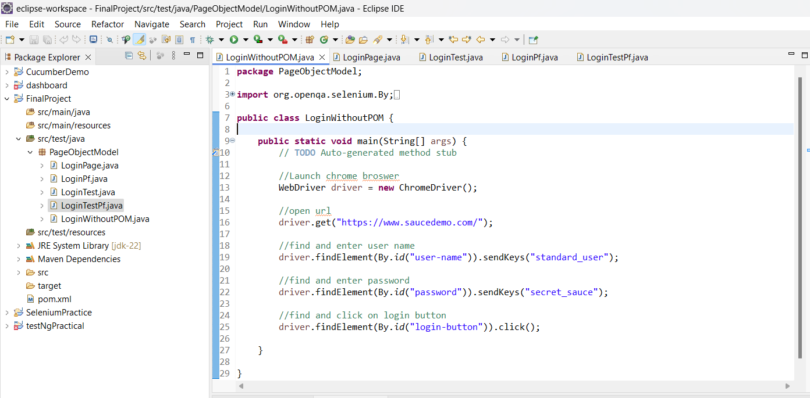
Project Implementation:
Login without POM:

Slide 9
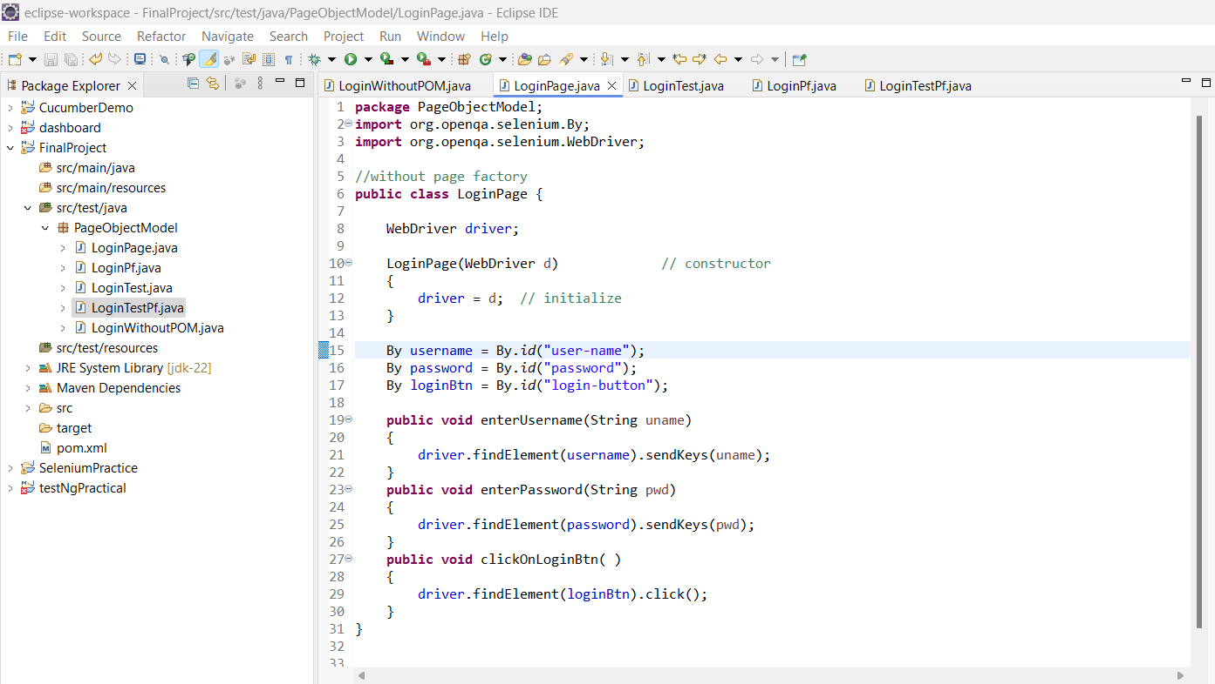
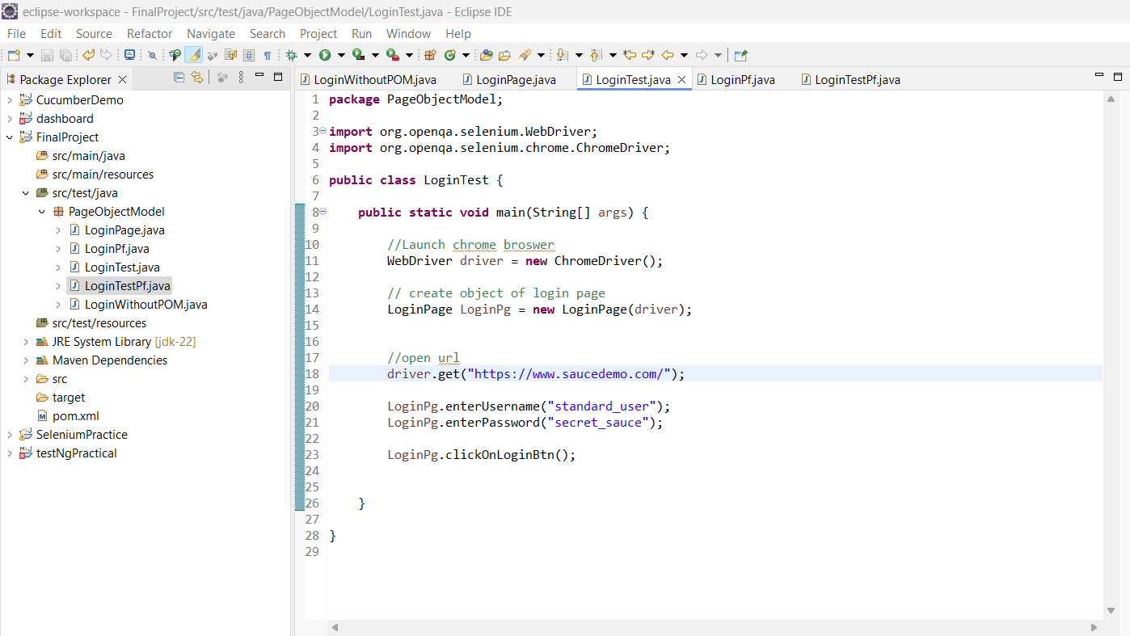
Project Implementation:
Login with POM:

Slide 10
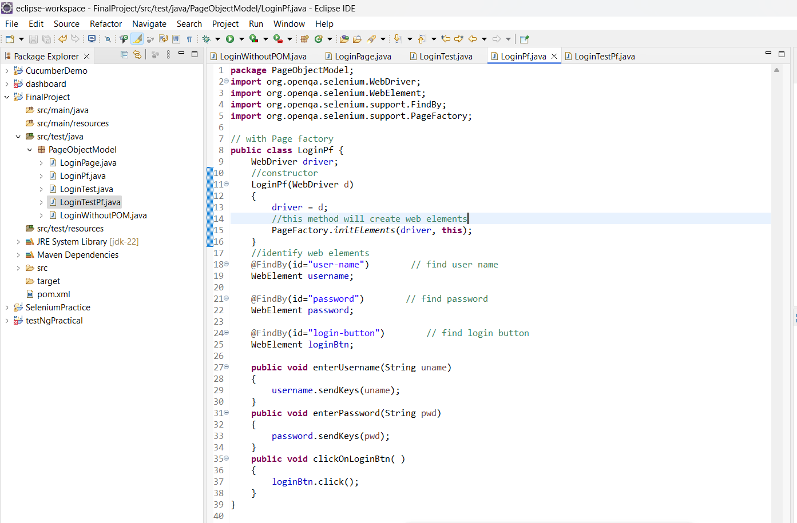
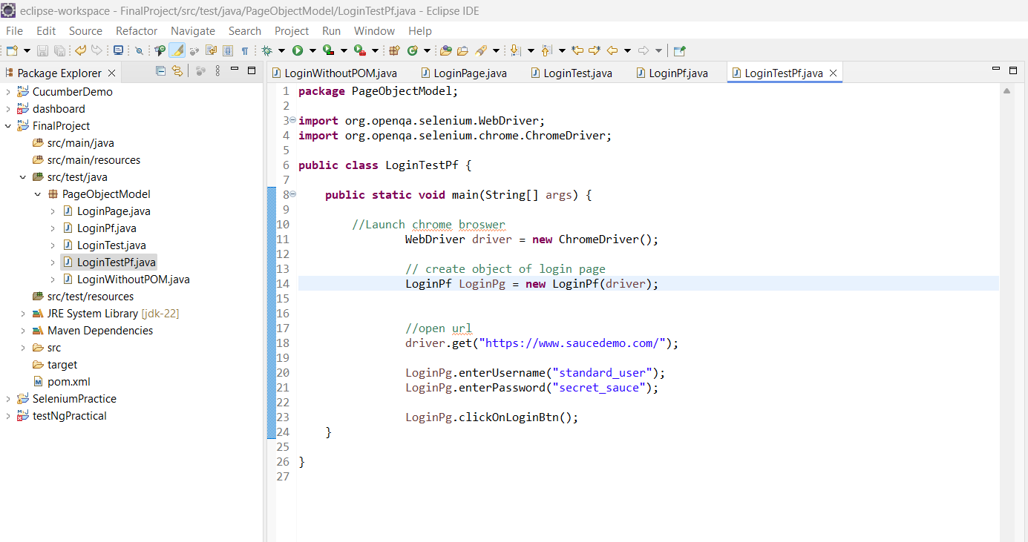
Project Implementation:
Login with POM using Page Factory:

Slide 11
Conclusion
By using POM, you can easily maintain and update your automation code. It provides reusability and modularity, as the code is organized into different modules. Additionally, it simplifies code maintenance and debugging by separating the test logic from the test data and object repository.
Overall, the Project Object Model in Selenium helps in creating a structured and scalable automation framework, improving code readability, and enhancing efficiency and productivity in test automation projects.
The Page Factory design pattern is used in conjunction with the Page Object Model (POM) to implement a more maintainable and scalable automation framework. It helps in initializing the Web Elements in a Page Object Model class and improves the performance of the tests.

Slide 12
THANK YOU

